Slide 1
Analysis of
Concrete Architecture of Apollo Platform
Group Leader: Hairuo Li
Slides: Jialing Gong
Presentation: Muyun Sai
Report:
Yuxuan Yang/Jialing Gong/Muyun Sai
Yuxin Huang/Hairuo Li/Songyu Yang
CISC322 22W A2

Slide 2
mapping the source code
by the tool Understand
(New)
Show the dependency between
modules
Five parts
Conceptual
V.S. and modify
Concrete
too high-level
imagination fills most of the understanding
OVER
VIEW
(Previous)

Slide 3
01
Architecture
CONtents
Compare the concrete to the conceptual
contents
02
Unexpected Dependencies Analysis
Specific analysis of the differences
03
Subsystem Analysis: Routing
One of the subsystem that wotrh analysing
04
Sequence Diagrams
New sequence diagrams

Slide 4
05
Team Issues
CONtents
Issues during research
contents
06
Concurrency
Concurrency in Apollo
07
Limitations
What we still can't achieve
08
Lessons Learned
What benefits us

Slide 5
01
Architecture
Compare the concrete to the conceptual
PART 01

Slide 6
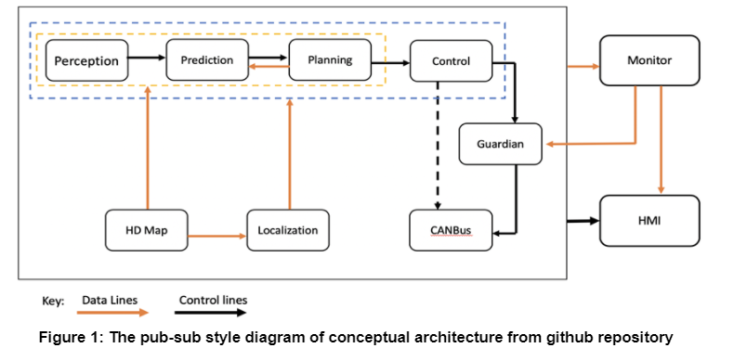
Architecture: Recap of Conceptual Architecture
We’ve mentioned it in former presentation

Slide 7
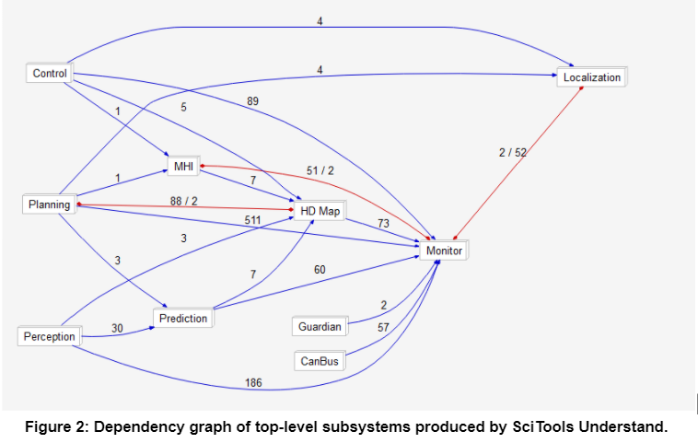
Architecture: Derivation Process
Understand tools help to map the source code
source codes are reclassified
many of the dependencies are more visible
In order to minimize unexpected dependencies, dependencies with too little weight will be removed.

Slide 8
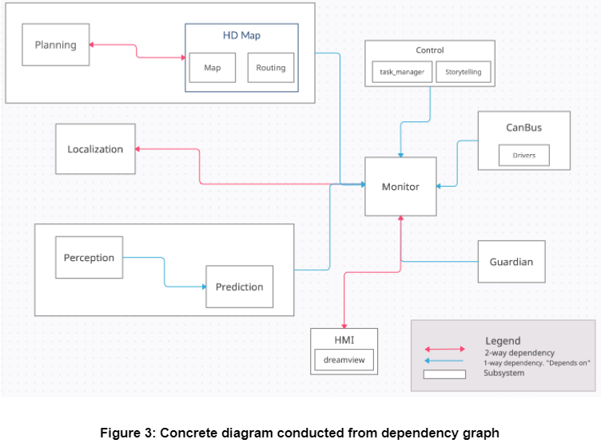
Architecture: Concrete Architecture

Slide 9
Architecture: Concrete Architecture
Monitor
all other subsystems are connected with it
HMI, Guardian, CanBus, Control, Localization
relatively simple
Perception and the Prediction

Slide 10
02
Unexpected Dependencies Analysis
Specific analysis of the differences
PART 02

Slide 11






Unexpected Dependencies Analysis
planning and prediction
control and canbus
Unexpect
Dependency
five missing dependencies
Missing
Dependency

Slide 12





Unexpected Dependencies Analysis: Missing Dependencies
1
2
3
Prediction and Planning
Planning and Control
Control and Guardian
4
5
Guardian and CANBus
Localization and
HD-Map

Slide 13
Unexpected Dependencies Analysis: Missing Dependencies
We believe that this is due to the supervisory role of the monitor.
Confirm
Analyze
01
02
Look at the code inside the monitor:
the data flow & control flow are implemented through the monitor.
Find the main function of common/util:
to process files and to read and write to files.

Slide 14
Unexpected Dependencies Analysis: Localization and Monitor
Original Dependency: thought to be a single dependency of localization on monitor
Concrete's Research: many dependencies.
the common/vehicle-state module:
dependent on localization, represent vehicle information
the vehicle coordinates:
dependent on the localization module

Slide 15
Unexpected Dependencies Analysis: Planning and HD Map
Original Dependency: one-way dependency of planning on HD Map
Concrete's Research: two-way dependency
the results of the routing, convert each section into the form of reference_line data
the parsing of the routing data leads to a dependency on planning

Slide 16
03
Subsystem Analysis: Routing
One of the subsystem that wotrh analysing
PART 03

Slide 17
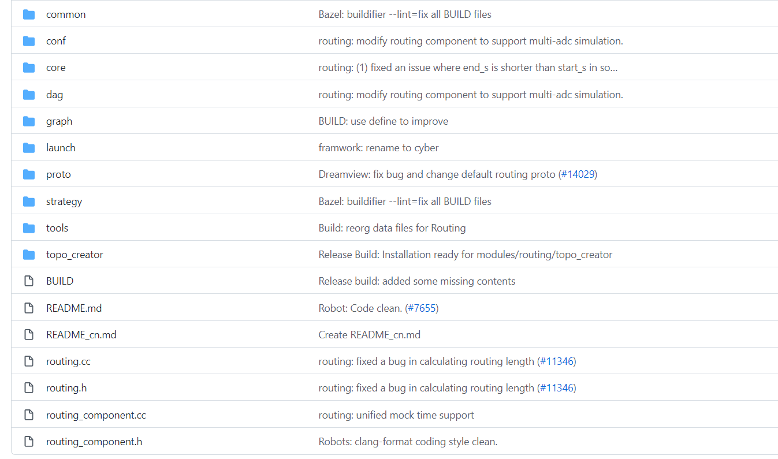
Subsystem Analysis: Routing
Main Role: to generate routing information based on requests
Important subsystem:
Common, Graph, Topo_creator, Core, Strategy, Routing result, and Routing component.
Routing component:
looks externally for the corresponding files based on the requirements within the subsystem.

Slide 18
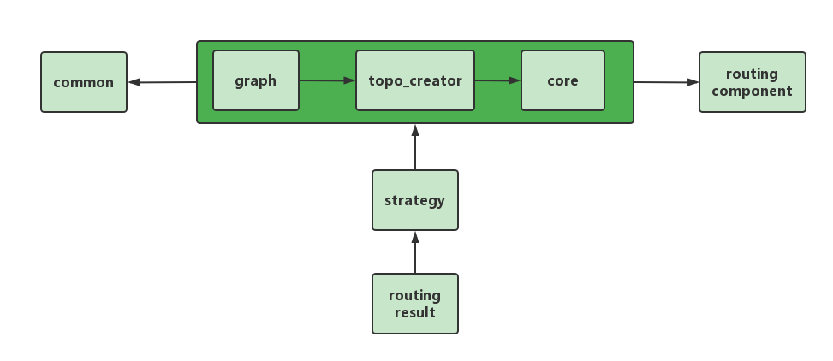
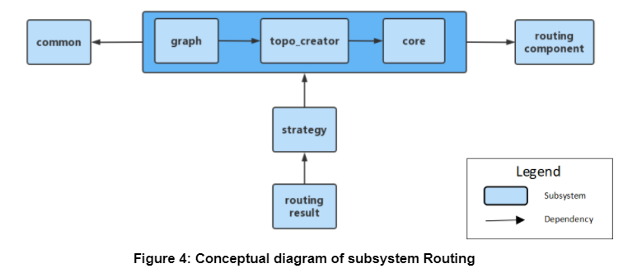
Subsystem Analysis: Routing

Slide 19
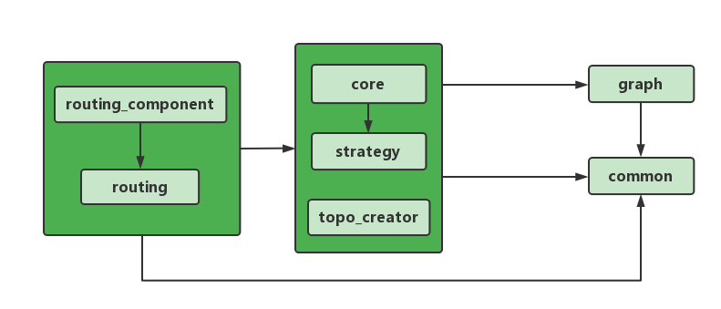
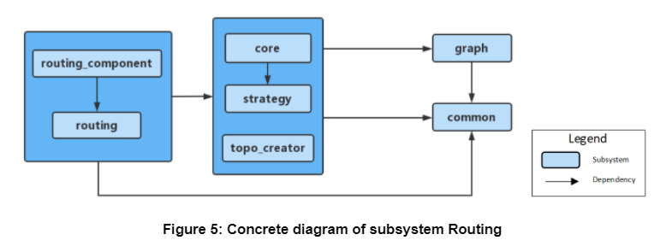
Subsystem Analysis: Routing

Slide 20
Subsystem Analysis: Routing - Graph and topo_graph
Guess: topo_creator convert topo's map type
Fact: graph is already a poto file externally

Slide 21
Subsystem Analysis: Routing - Strategy and Core
Guess: process the topo map for subsequent searches
Fact: only search for the shortest path

Slide 22
04
Sequence Diagrams
New sequence diagrams
PART 04

Slide 23
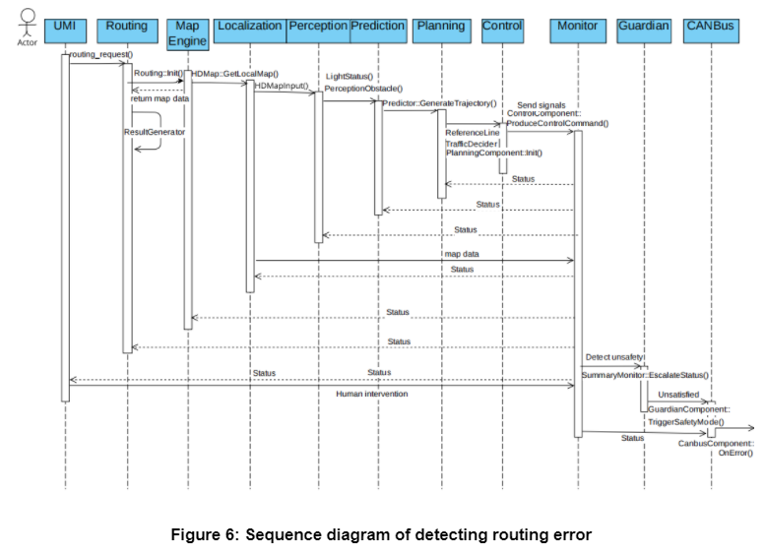
Sequence Diagrams - Use case 1: Detecting Routing Error

Slide 24
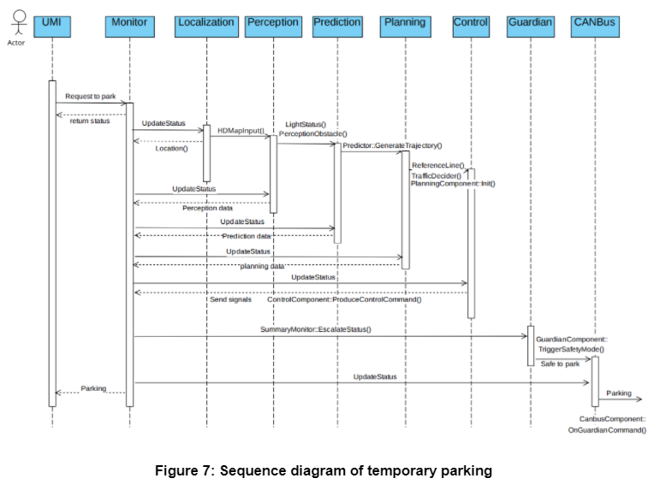
Sequence Diagrams - Use case 2: Temporary Parking

Slide 25
05
Team Issue
Issues during research
PART 05

Slide 26



Team Issue
Huge Differences
analysis become complex since it is hugely different from the analysis analyzed from conceptual architecture in Assignment 1
Previous Failures
conceptual architecture we wrote in Assignment 1 was much too specific

Slide 27
06
Concurrency
Concurrency in Apollo
PART 06

Slide 28


Concurrency
pub-sub style
events occur
within subsystem
message filter
achieve only subset of the total messages transmission
running on threads

Slide 29
07
Limitations
What we still can't achieve
PART 07

Slide 30


Limitations
Limitation 01
Limitation 02
understanding
significance of reality
do not have a good understanding of the code programming language
impossible to expand to other areas when discussing the significance of reality

Slide 31
08
Lessons Learned
What benefits us
PART 08

Slide 32

Lessons Learned
analyze the divergence between conceptual view and concrete view
based on our understanding of each subsystem
use SciTools Understand
know interactions and dependencies from an analytical point of view

Slide 33
Conclusion
focuses on the discrepancies between the conceptual and concrete architecture in the assigned subsystems

Slide 34
Reference
Microsoft Document. “Publisher-Subscriber pattern”. Retrieved from https://docs.microsoft.com/en-us/azure/architecture/patterns/publisher-subscriber
salmcode (August 23, 2017).“The First Part of the [Apollo Source Code Analysis] Series [common].” Retrieved from https://blog.csdn.net/learnmoreonce/article/details/77511338
Steve (October 20, 2021.)“Apollo 6.0 pnc_map Analysis” Retrieved from https://zhuanlan.zhihu.com/p/419350318
Yuchen C. Et. all. (2022).Assignment 1 : Conceptual Architecture of Apollo. Retrieved from https://docs.google.com/document/d/1f3Y1uISdpA9U6SUEgdXLMi7XItG2nFlHU3zRkkc4uMw/edit
Baidu. (n.d.). Apollo.(February 20, 2022) Retrieved from https://apollo.auto/
Paul (February 5, 2019). “Baidu Apollo's Routing Module”. Retrieved from https://paul.pub/apollo-routing/#id-topocreator

